Slide 1

Wildfire Assessment Desmond Lartey (PhD Candidate) David Flores (Research Social Scientist) 1 November 2023
c/o USDA

Slide 2
Discussion outline
Development of survey analysis tool
Function of survey analysis tool
Key survey highlights
Next steps…

Slide 3
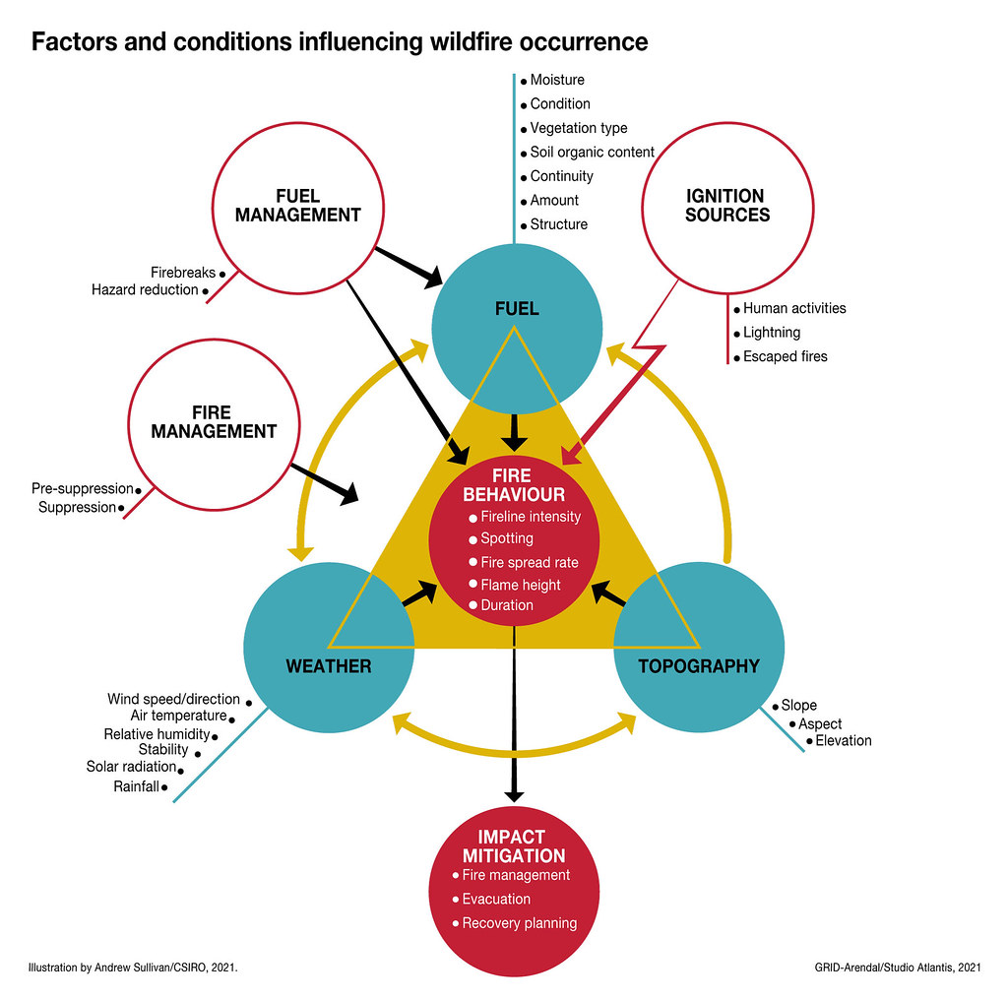
Readiness
Review and Analysis
Risk Reduction
Recovery
Response

Slide 4
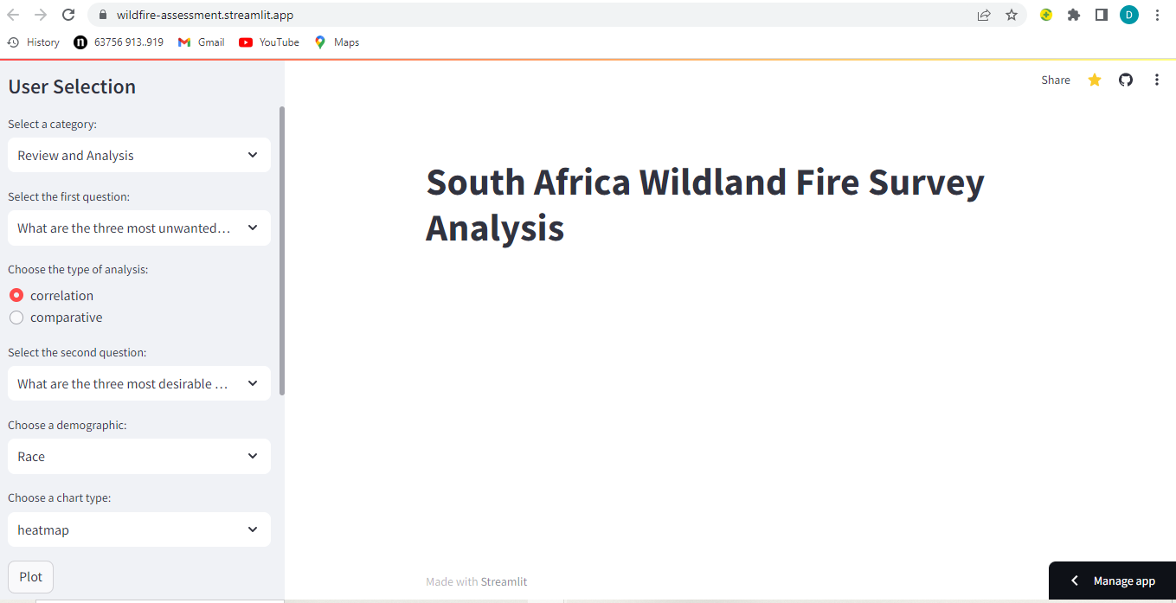
Using the app-Note: It uses a 1-to-many algorithm with respondent ID as the key
Result/Chart display

Slide 5
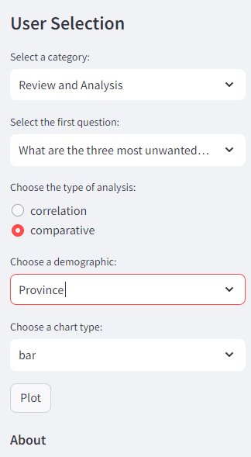
The categories are grouped into (FAO) 5 R’s guidelines and others
Base on the ‘R’ selected, you get a set of possible questions to choose from
Choose comparative for a better understanding of how responses differ
Correlation doesn’t work properly in this app except in a Jupyter notebook environment
For a better user experience, choose all chart type except heatmap. But you can just use heatmap to understand a cluster of responses or feature importance in a Jupyter notebook environment.

Slide 6
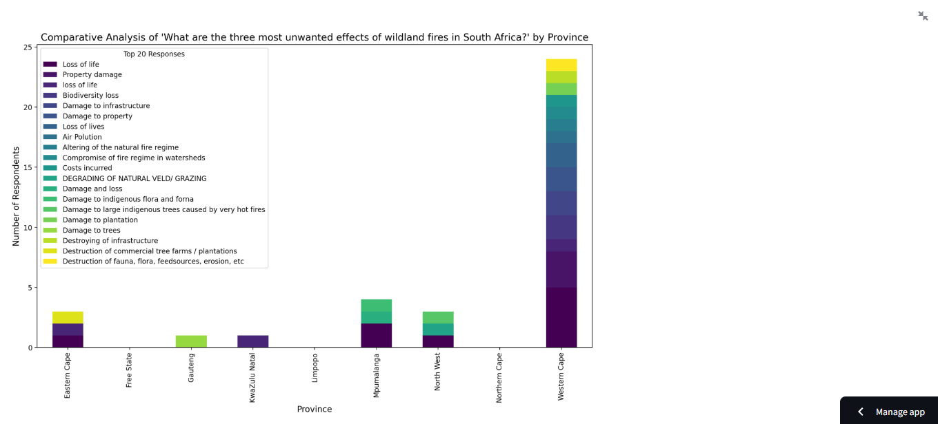
Click this sign here to expand results or to go back to the main app page
Check here for a detailed report of how the algorithms works
https://github.com/desmond-lartey/Wildfire-Assessment/blob/Fires/README.md

Slide 7
Key highlights- for an explanation of the charts in the 5 categories please read more here https://github.com/desmond-lartey/Wildfire-Assessment/blob/Fires/README.md
Review and Analysis

Slide 8
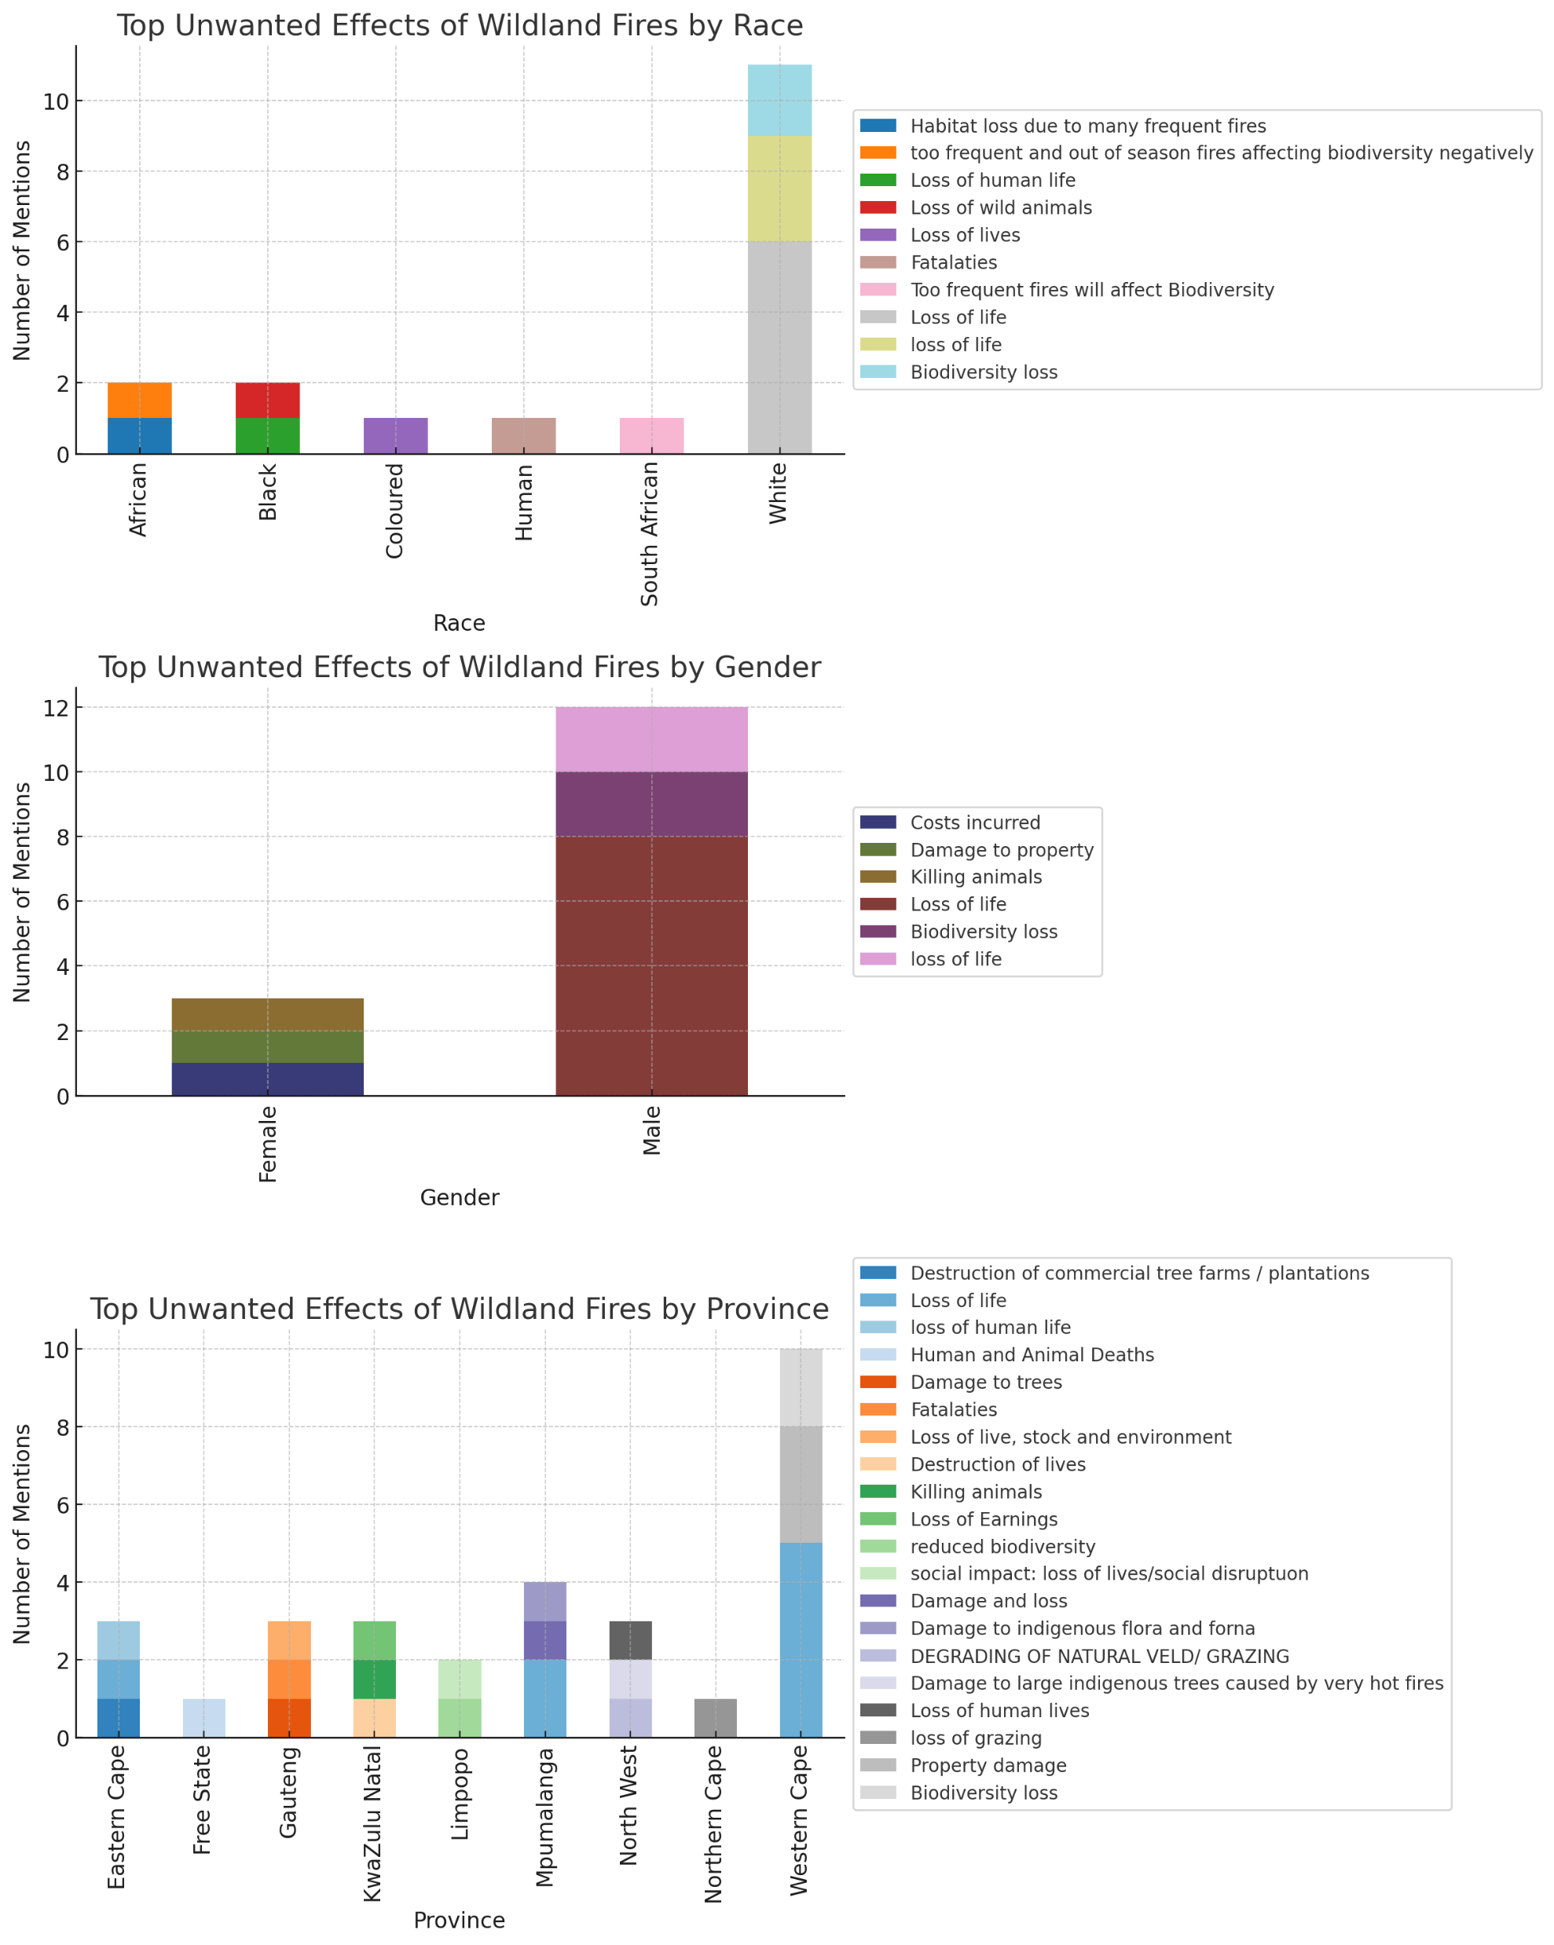
Interesting Highlights:
Loss of Life is Universal: Regardless of race, gender, or province, the loss of life due to wildland fires is the predominant concern. This underscores the human cost associated with these fires and the universal desire for safety.
Ecological Concerns are Evident: Several respondents, especially from the White demographic and provinces like Eastern Cape and Limpopo, express concerns about biodiversity loss and habitat destruction. This indicates an awareness of the environmental implications of wildland fires.
Economic & Property Impacts: Concerns about property damage, loss of grazing, and the destruction of tree farms emphasize the economic toll of these fires, especially in provinces where agriculture and forestry might be significant contributors to the local economy.

Slide 9
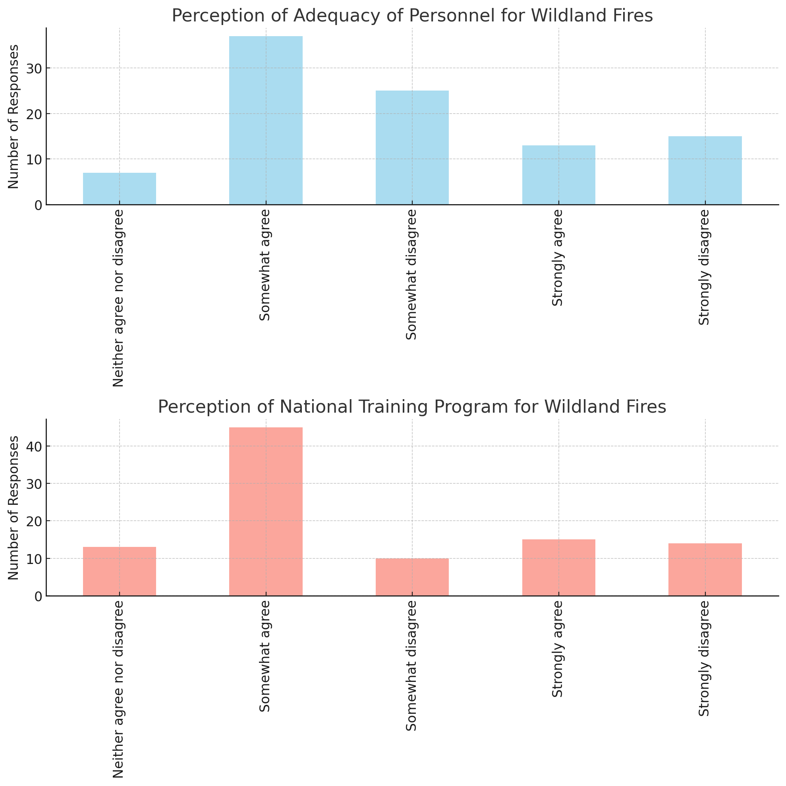
Perception of Adequacy of Personnel for Wildland Fires
A significant number of respondents (37) "somewhat agree" that there's adequate personnel.
However, there's also a considerable segment (40 in total) that either "somewhat disagrees" or "strongly disagrees," indicating potential concerns about personnel readiness.
Perception of National Training Program for Wildland Fires
Most respondents lean towards agreeing (either "somewhat" or "strongly") that there's a national training program.
Yet, a sizable number also disagrees, revealing potential gaps or disparities in awareness or implementation of the program.

Slide 10
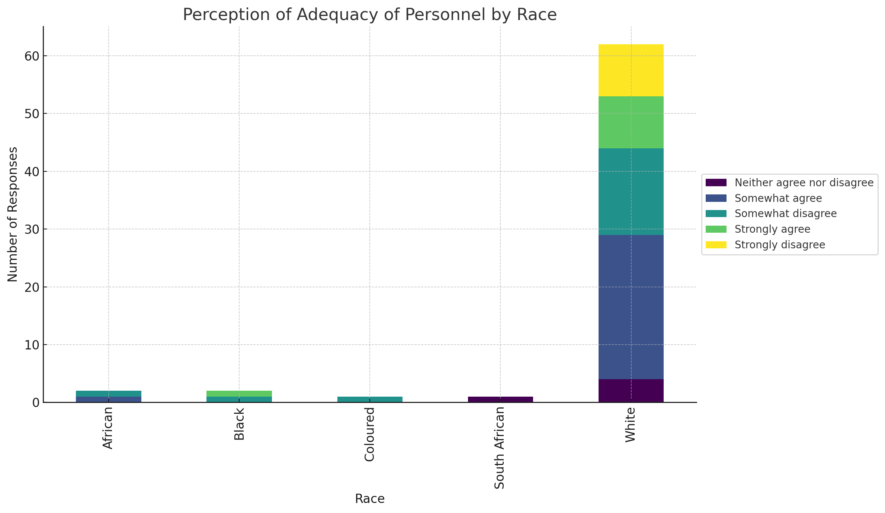
Observations:
White Respondents: A significant segment "somewhat agrees" with the adequacy of personnel. However, there's also a sizable portion that "somewhat disagrees" or "strongly disagrees."
African, Black, Coloured, and South African Respondents: The distribution of perceptions varies, with some respondents showing agreement, while others disagree or remain neutral.
Key Highlight:
The White demographic, which provided the majority of responses, shows a mixed perception regarding personnel adequacy. This indicates potential disparities in readiness across regions or communities within South Africa.

Slide 11
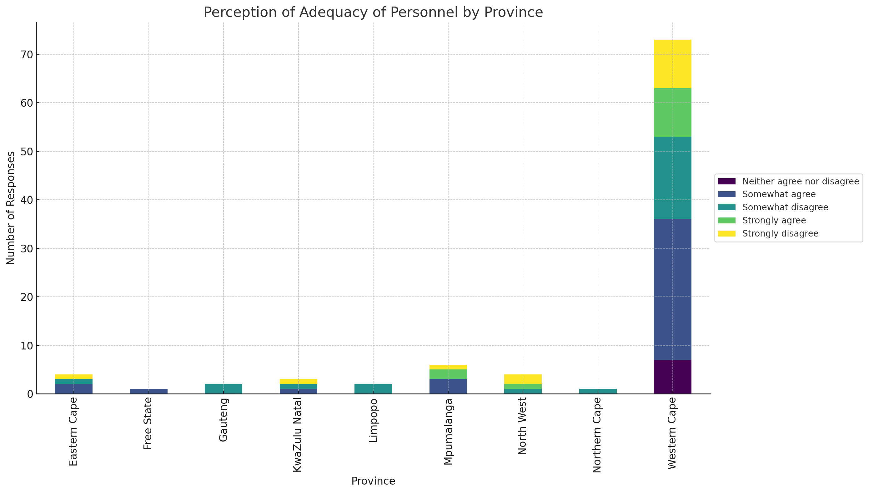
Observations:
Western Cape: Most respondents in this province "somewhat agree" with the adequacy of personnel, but there's also a noticeable segment that "strongly disagrees."
Eastern Cape & Gauteng: These provinces show a mix of agreement and disagreement regarding personnel adequacy.
Other Provinces: While the response counts are smaller, there's a diversity of perceptions across provinces like Free State, KwaZulu Natal, Limpopo, Mpumalanga, and North West.
Key Highlight:
There's a mixed perception regarding personnel adequacy across different provinces. This suggests regional disparities in the perception of readiness, potentially due to varying fire management strategies, resources, and experiences with wildland fires.

Slide 12
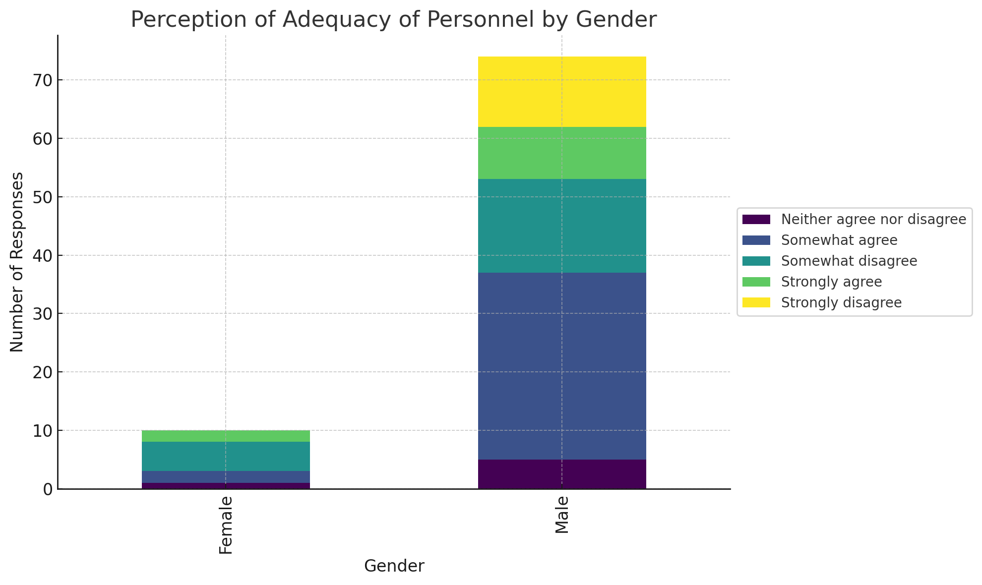
Observations:
Male Respondents: A considerable number "somewhat agree" with the adequacy of personnel, but there's also a significant segment that "somewhat disagrees" or "strongly disagrees."
Female Respondents: The perceptions are diverse, with responses spread across agreement, disagreement, and neutrality.
Key Highlight:
Both genders have a mixed perception regarding personnel adequacy, suggesting that concerns about readiness are prevalent regardless of gender. However, male respondents seem to have a slightly more positive perception compared to female respondents.

Slide 13

readiness

Slide 14
Key Highlights:
Lack of Equipment in Western Cape: Both responses indicating the absence of equipment are from the Western Cape province. This is concerning, especially if wildland fires are prevalent in this region.
Diverse Demographic Concern: The lack of equipment is a concern expressed across both genders and by the Coloured demographic, indicating a broader community issue

Slide 15
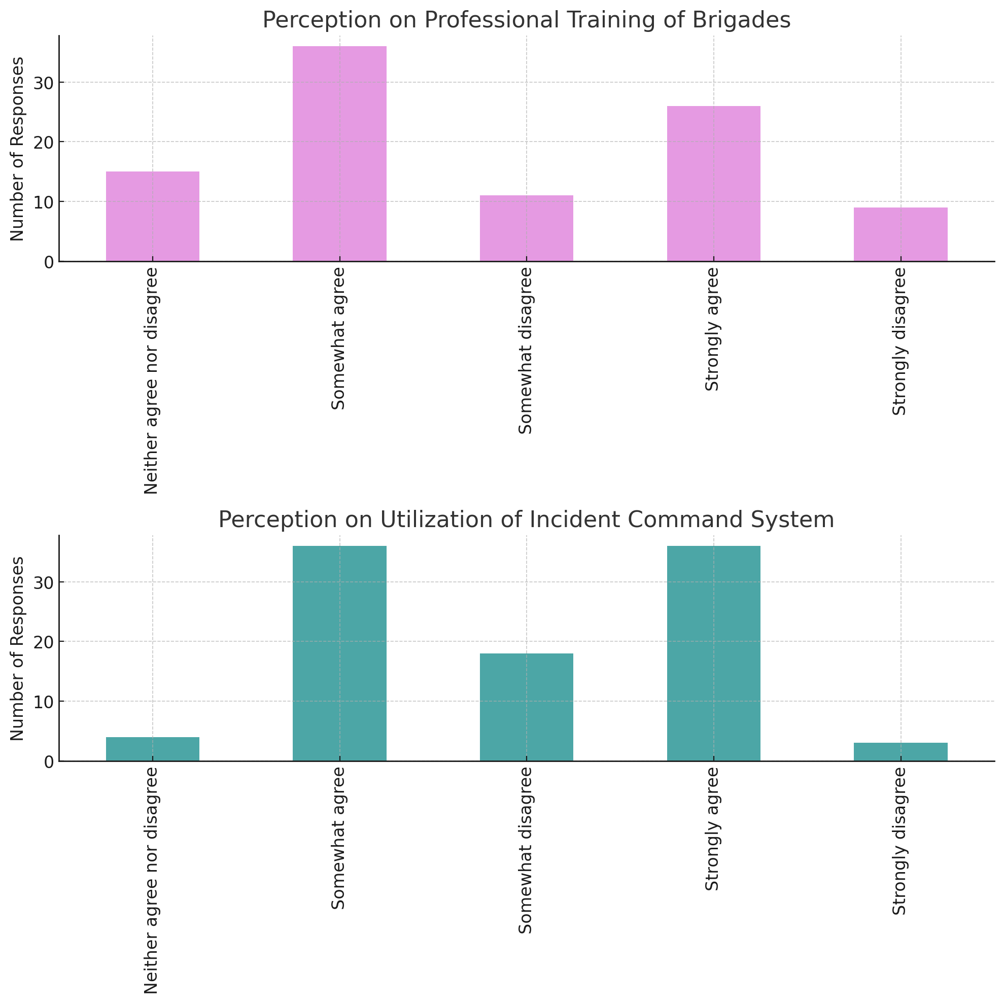
Perception on Professional Training of Brigades
A majority of respondents (62 in total) either "somewhat agree" or "strongly agree" that wildland fire suppression brigades are professionally trained and equipped.
However, there's also a segment (20 in total) that "somewhat disagrees" or "strongly disagrees," indicating potential concerns about the quality or extent of brigade training.
Perception on Utilization of Incident Command System
The majority (72 in total) either "strongly agree" or "somewhat agree" that a formal Incident Command System is utilized. This suggests a good level of structured command and control during wildfire incidents.
A smaller segment (21 respondents) either "somewhat disagrees" or "strongly disagrees."
Key Takeaways:
The overall perception suggests that there is a structured approach to managing wildland fires, with both professionally trained brigades and the utilization of an Incident Command System.
However, the concerns expressed by a segment of respondents indicate areas for improvement or potential disparities in the implementation of these systems across different regions or communities.

Slide 16
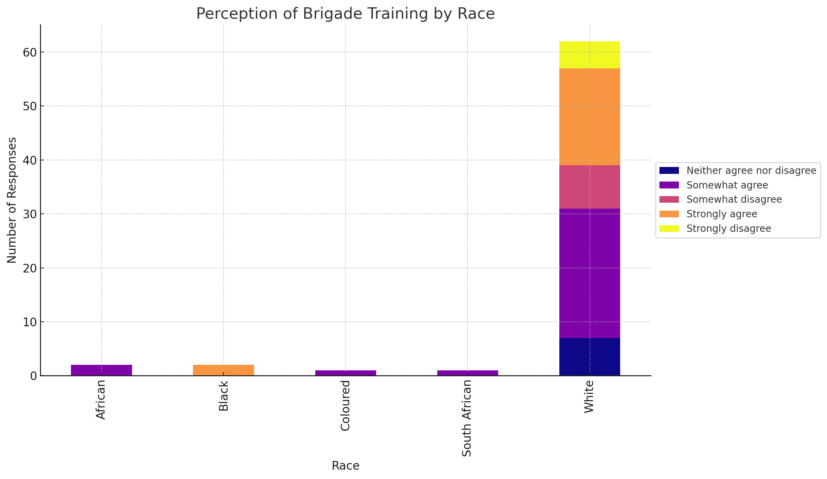
Observations:
White Respondents: A significant number "somewhat agree" with the adequacy of brigade training, but there's also a noticeable segment that "strongly disagrees" or "somewhat disagrees."
African, Black, Coloured, and South African Respondents: The distribution of perceptions varies, with some respondents showing agreement, while others disagree or remain neutral.

Slide 17
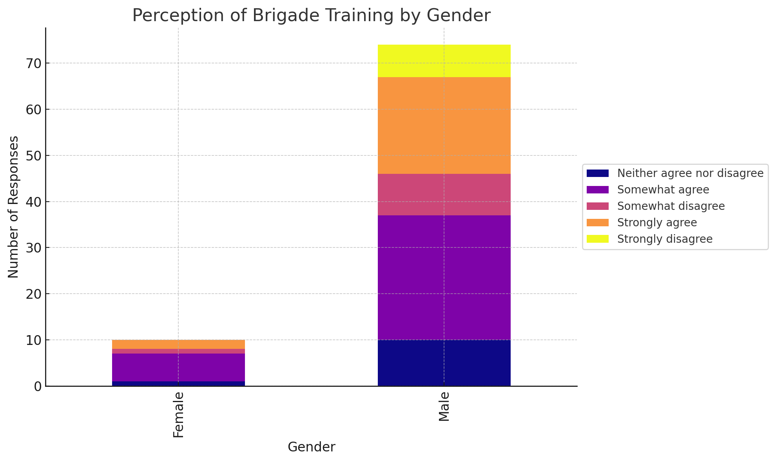
Observations:
Male Respondents: A considerable number "somewhat agree" with the adequacy of brigade training. However, there's also a segment that "strongly disagrees" or "somewhat disagrees."
Female Respondents: The perceptions are diverse, with responses spread across agreement, disagreement, and neutrality.

Slide 18
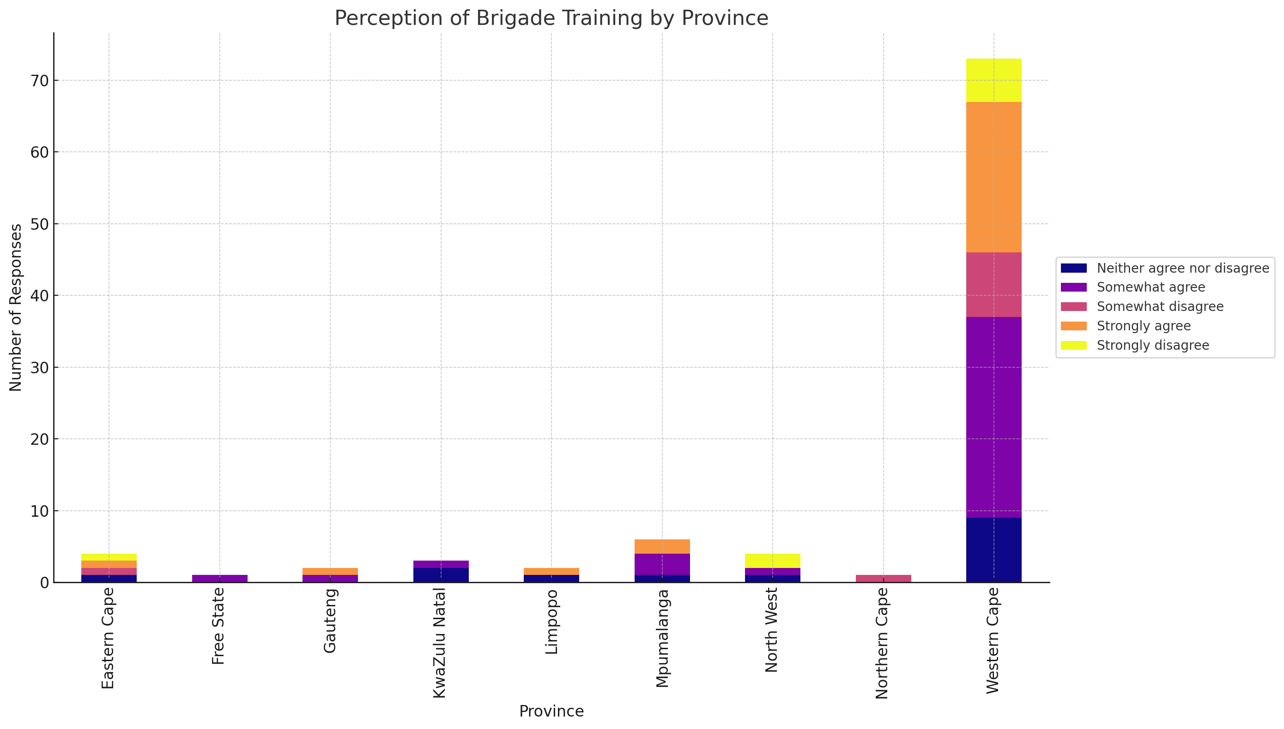
Observations:
Western Cape: This province has a dominant number of respondents who "somewhat agree" with the adequacy of brigade training. However, there's also a noticeable segment that "strongly disagrees."
Eastern Cape & Gauteng: These provinces show a mix of agreement and disagreement regarding brigade training.
Other Provinces: Provinces like Free State, KwaZulu Natal, Limpopo, Mpumalanga, and North West have diverse perceptions, albeit with fewer responses.

Slide 19
Recovery

Slide 20
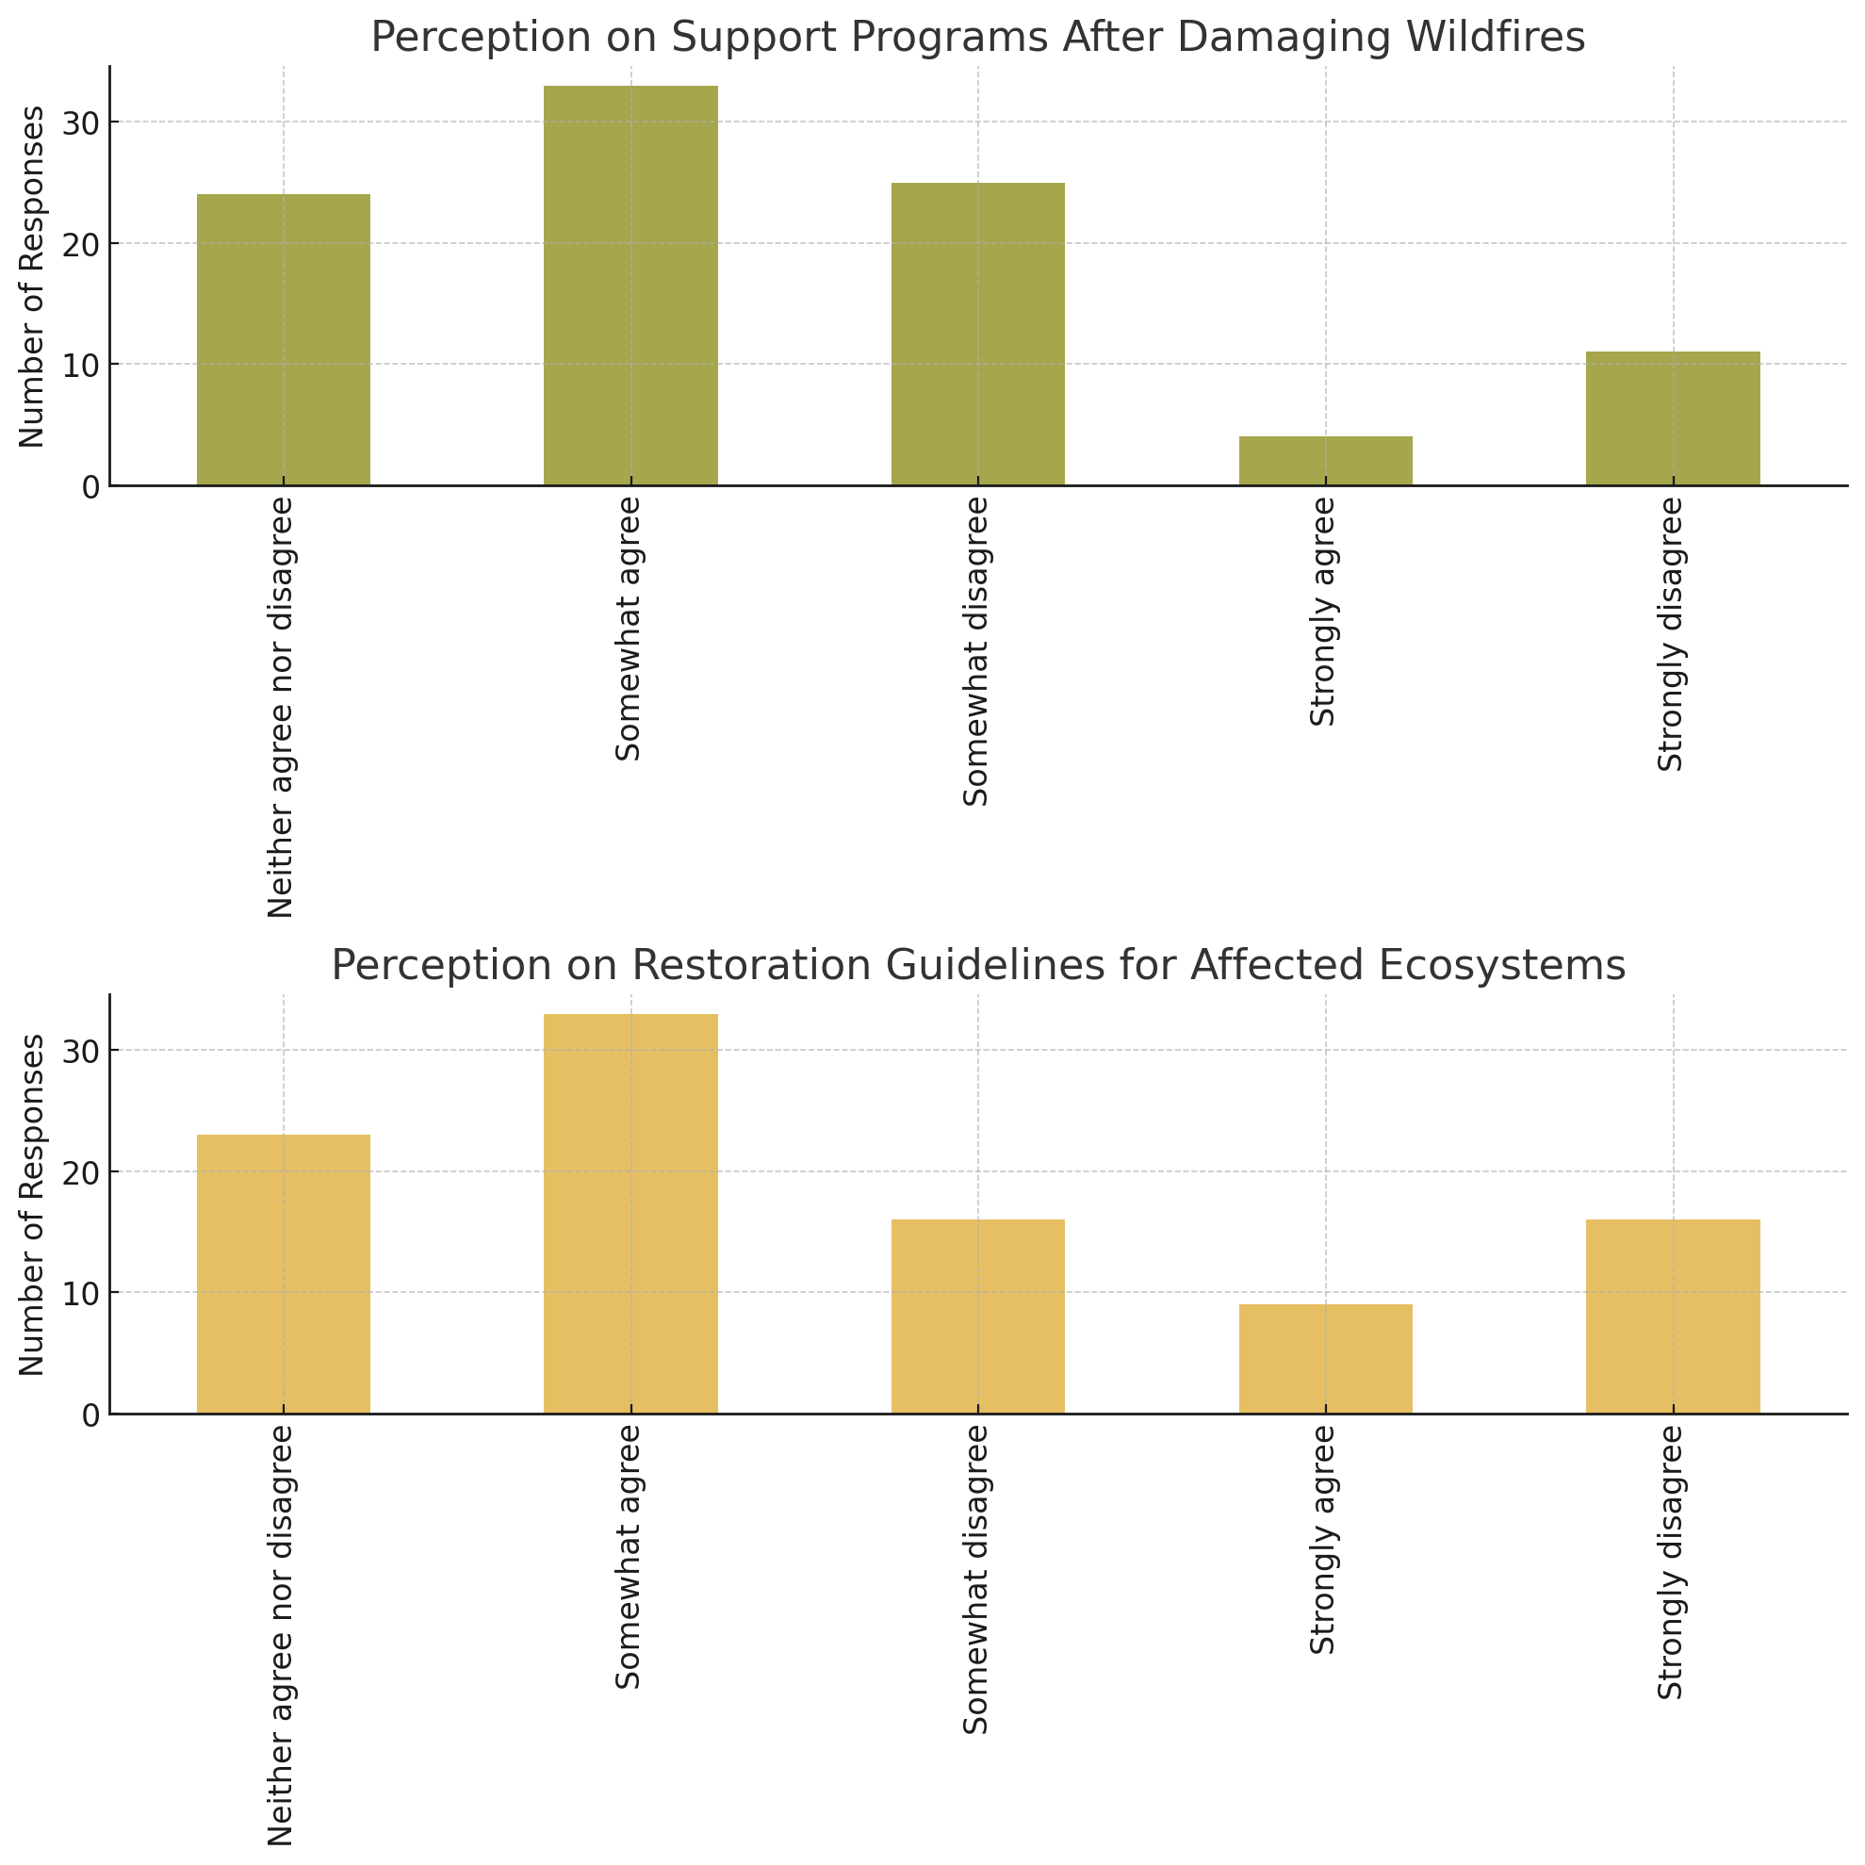
Perception on Support Programs After Damaging Wildfires
While a significant number of respondents (33) "somewhat agree" that there are support programs after damaging wildfires, there's also a notable segment (36 in total) that either "somewhat disagrees" or "strongly disagrees."
This indicates potential gaps in the implementation or awareness of post-fire support programs.
Perception on Restoration Guidelines for Affected Ecosystems
A majority (42 in total) either "somewhat agree" or "strongly agree" that there are restoration guidelines for affected ecosystems.
However, there's also a sizable number (32 in total) that either "somewhat disagrees" or "strongly disagrees," suggesting concerns about the guidelines' effectiveness or scope.

Slide 21
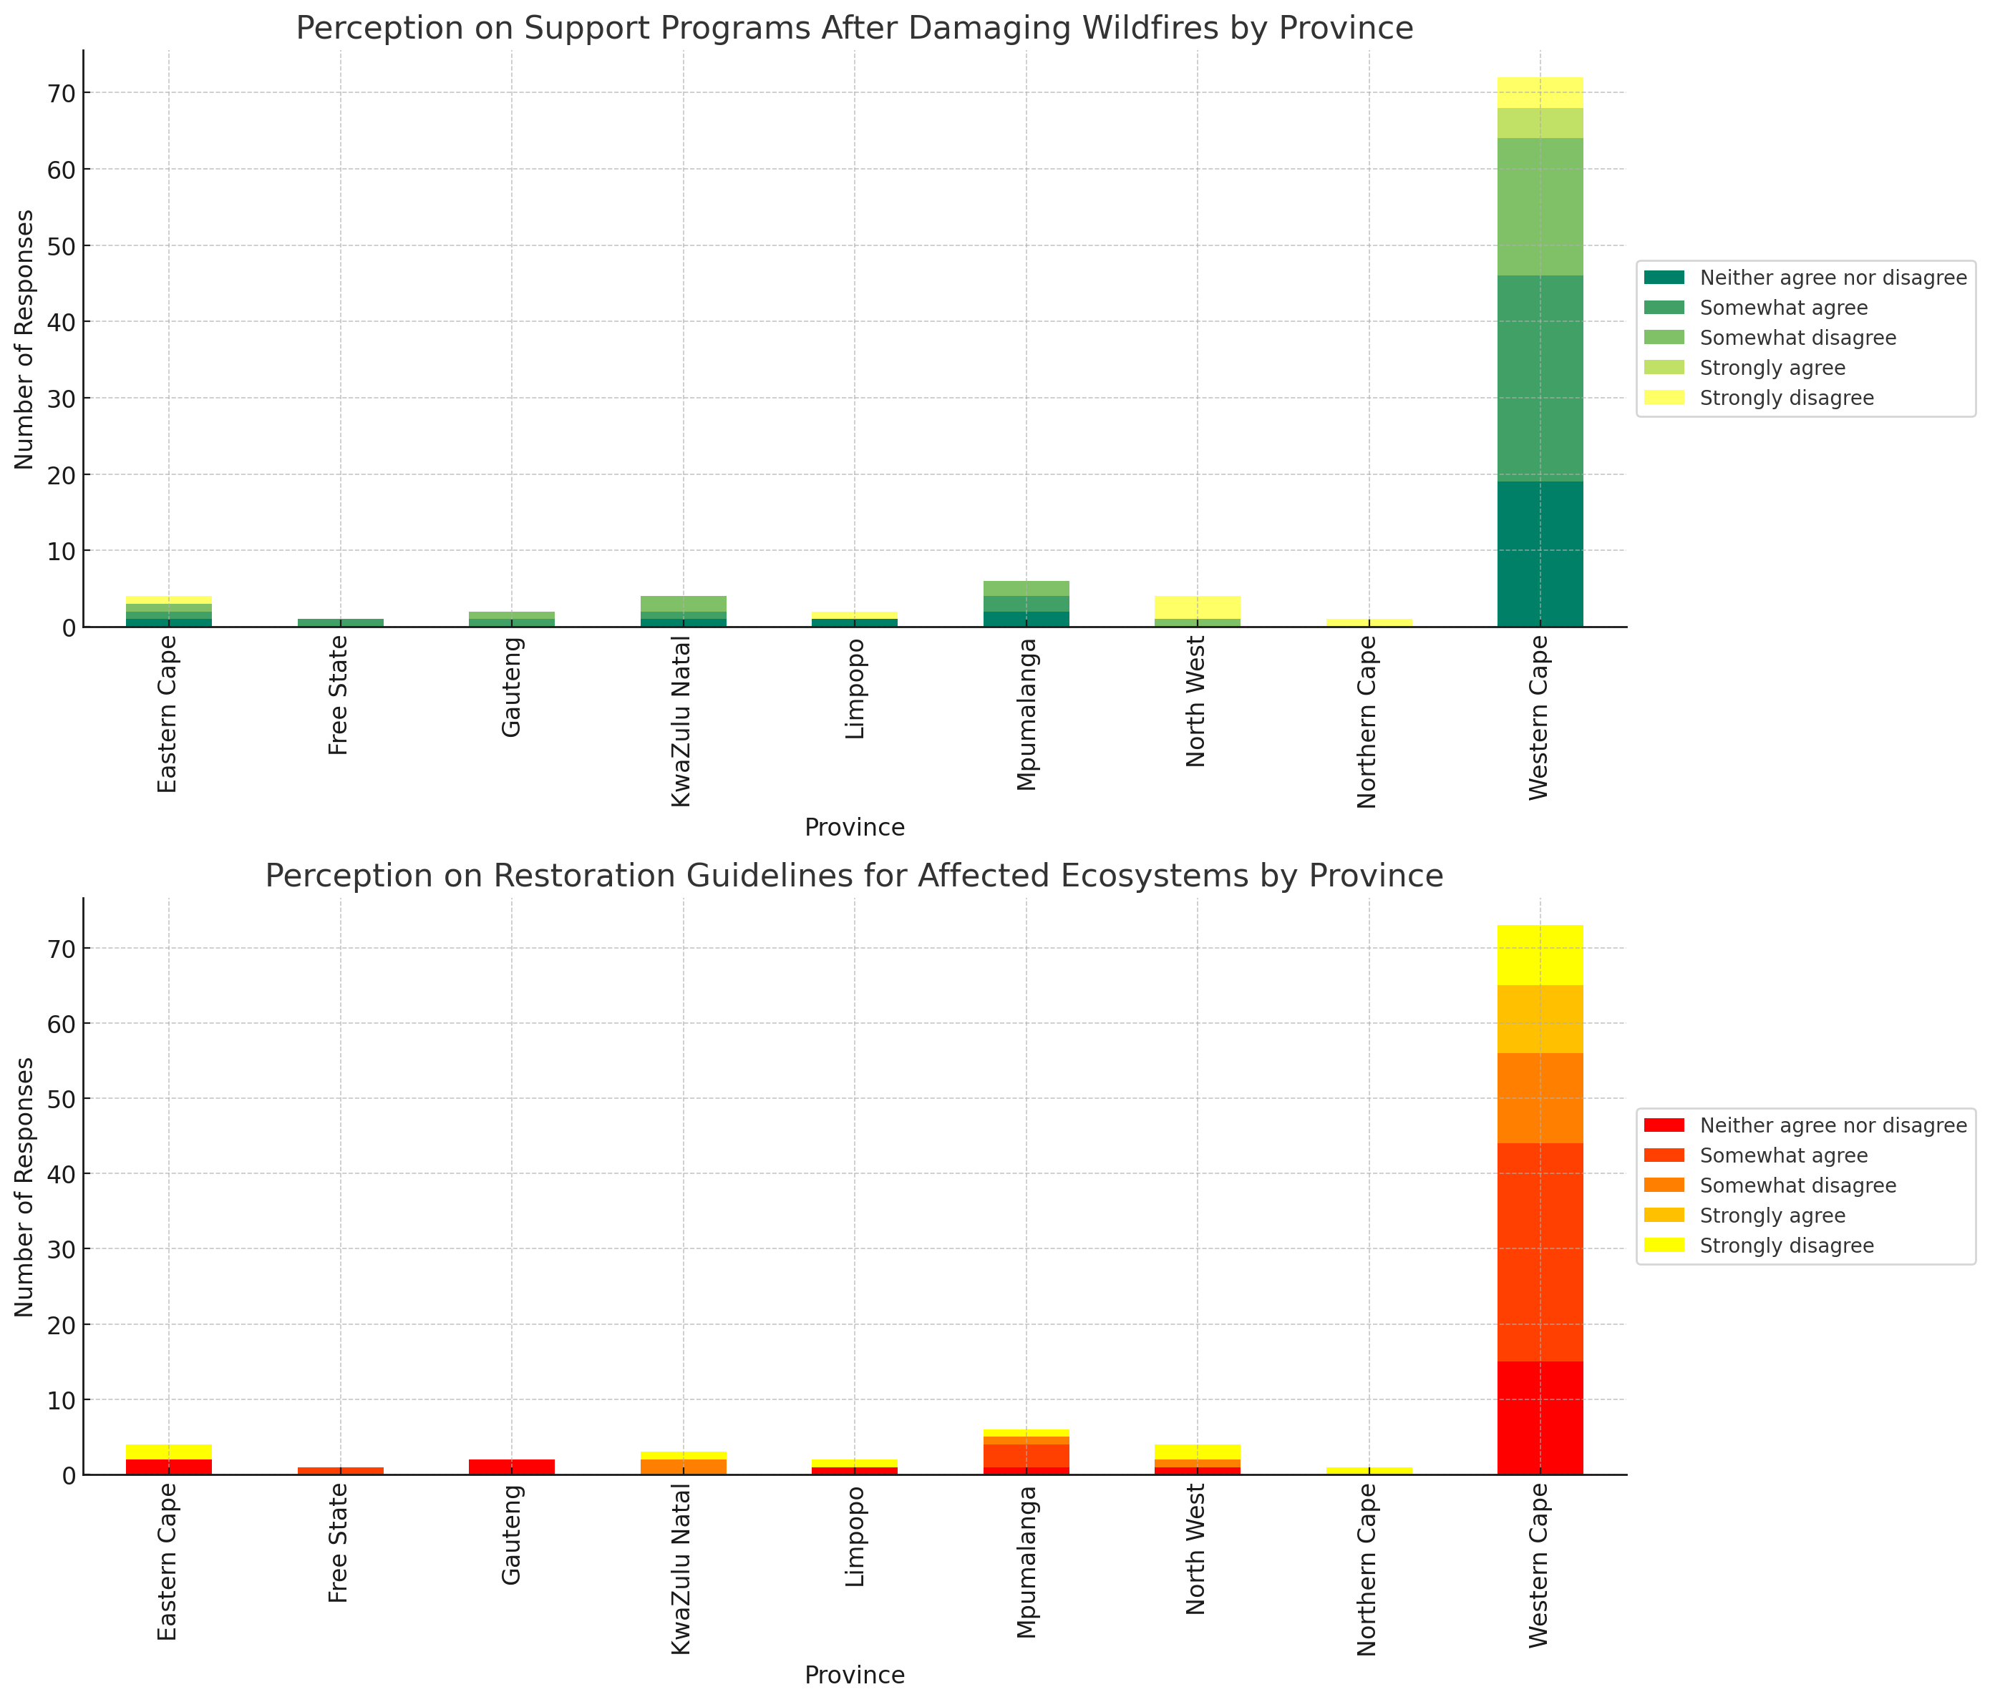
Perception on Support Programs After Damaging Wildfires
Western Cape: This province has diverse perceptions, with a significant number "somewhat agreeing" but also several "strongly disagreeing."
Other provinces like Eastern Cape, Free State, Gauteng, and KwaZulu Natal also exhibit mixed perceptions.
Perception on Restoration Guidelines for Affected Ecosystems
Again, Western Cape has mixed perceptions, though a noticeable segment "somewhat agrees."
Provinces like Eastern Cape and Gauteng also show a variety of views on restoration guidelines.

Slide 22
Response

Slide 23
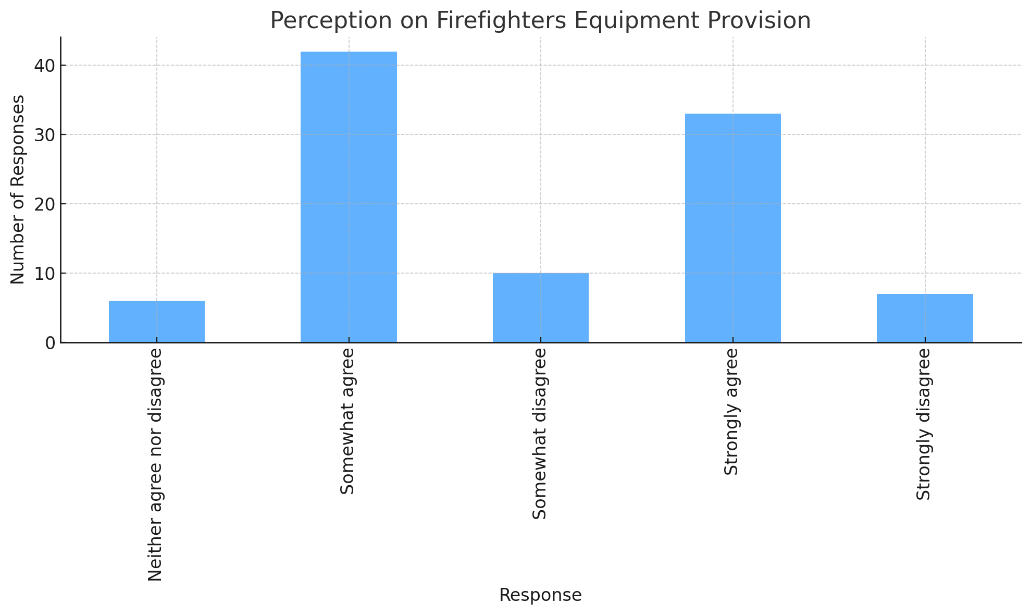

Slide 24
A majority of respondents (75 in total) either "strongly agree" or "somewhat agree" that firefighters are equipped with the necessary protective gear.
However, there's a segment (17 in total) that either "somewhat disagrees" or "strongly disagrees," indicating potential concerns about the quality, adequacy, or distribution of equipment.

Slide 25
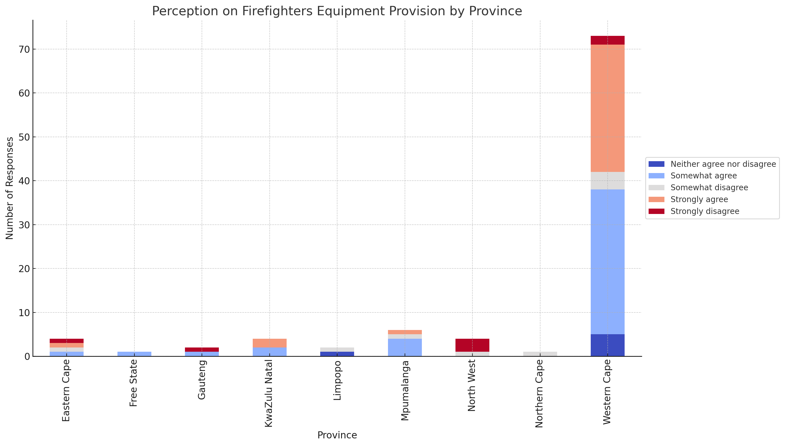
Observations:
Western Cape: Most respondents in this province "somewhat agree" with the adequacy of equipment provision for firefighters. However, there's a noticeable segment that "strongly disagrees" or "somewhat disagrees."
Eastern Cape & Gauteng: These provinces exhibit mixed perceptions with a spread across agreement and disagreement.
Other Provinces: While the response counts are smaller in provinces like Free State, KwaZulu Natal, and Mpumalanga, there's still a diversity of perceptions.
The regional variations suggest that the provision or quality of equipment might differ across provinces, leading to varying perceptions of response readiness.

Slide 26
Risk reduction

Slide 27
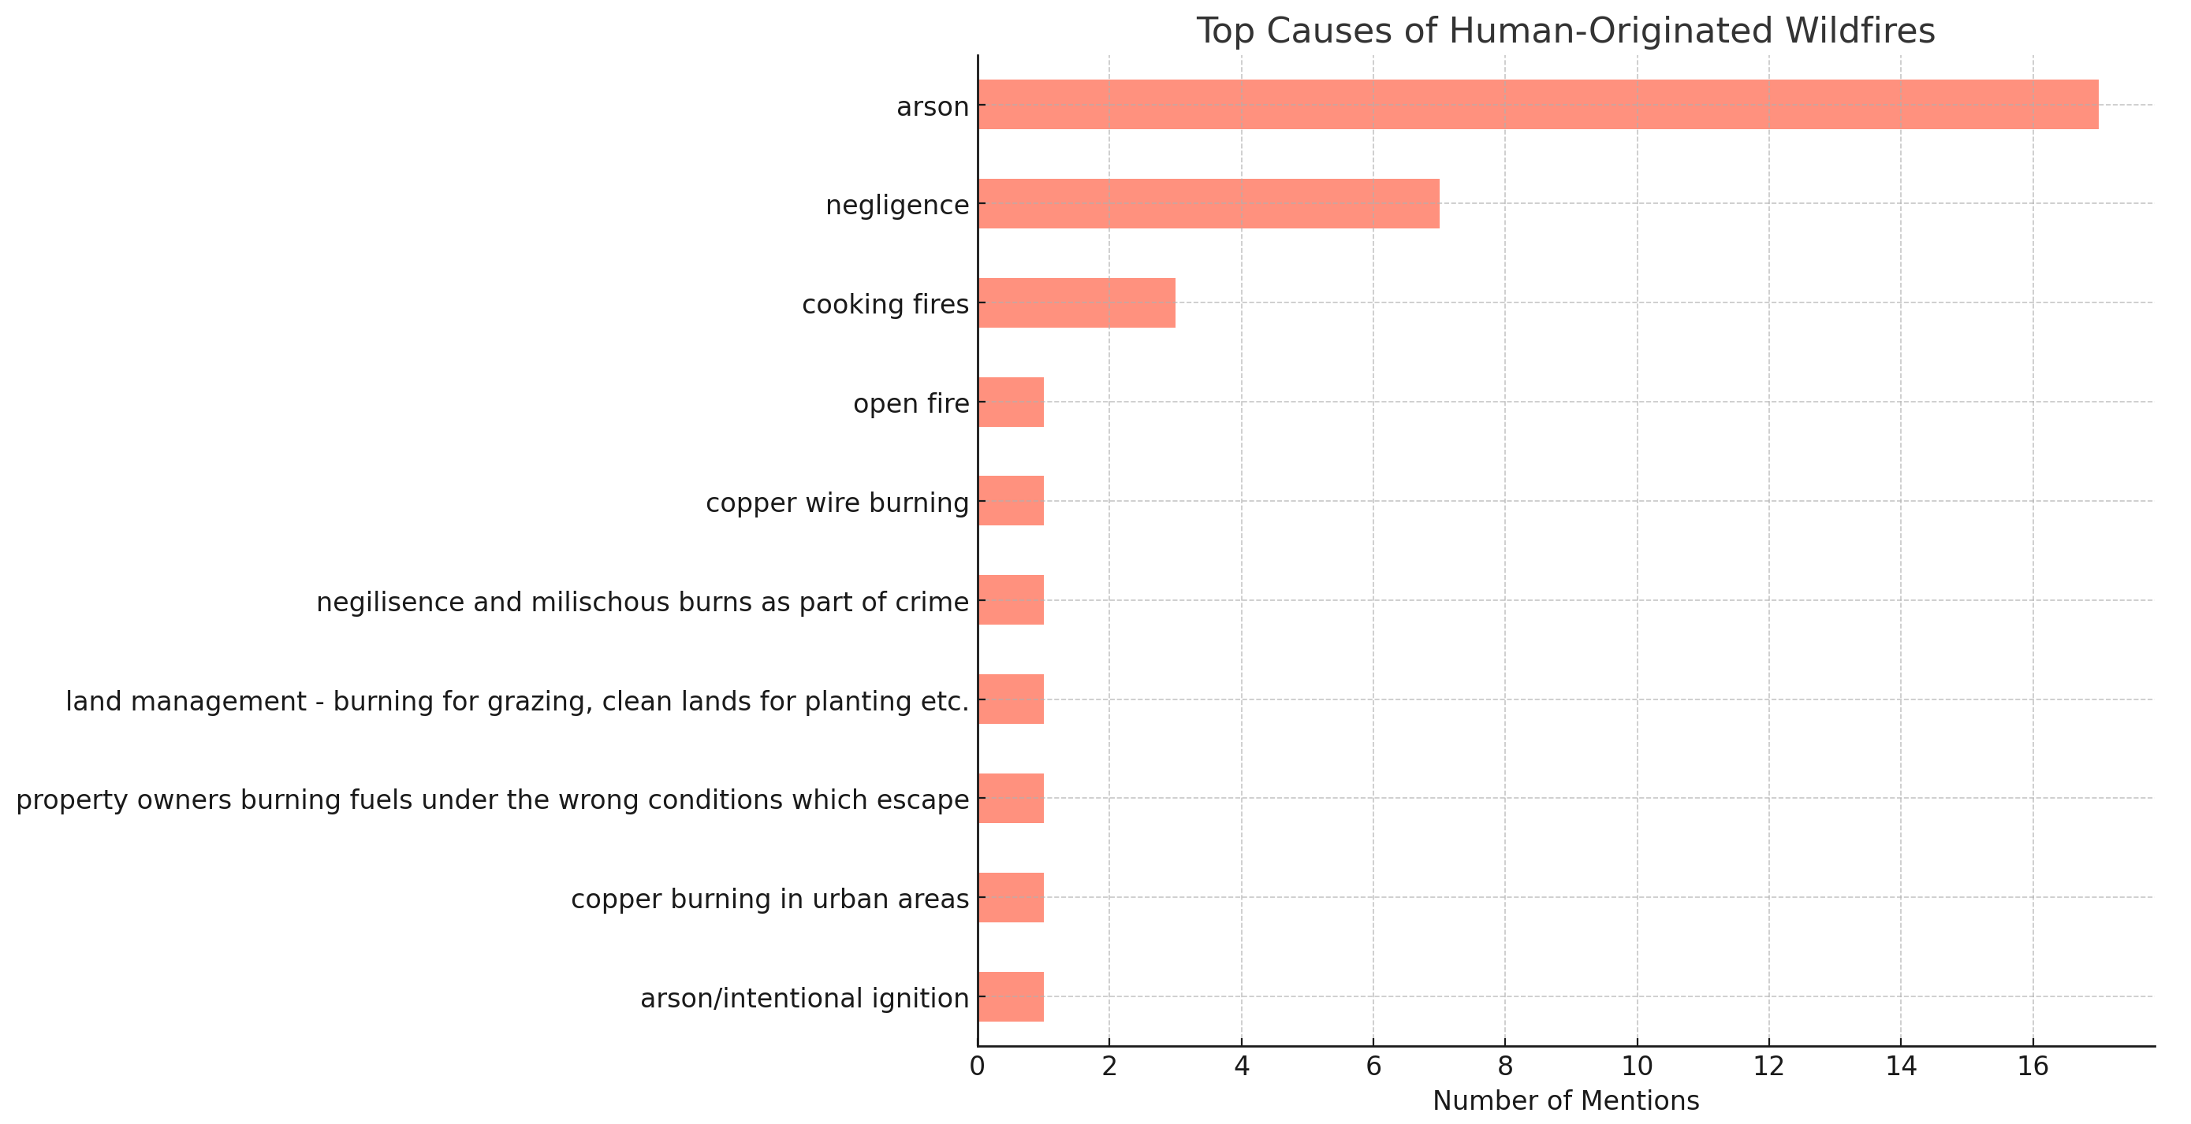
Top Causes of Human-Originated Wildfires
Arson is the most frequently mentioned cause, followed by negligence.
Other causes like cooking fires, powerlines, and burning of rubbish have been mentioned by respondents, among others.
Intended Purpose for Intentionally Set
Arson is the dominant purpose, followed by grazing and fuel management.
Unrest and land clearing are also mentioned, indicating various motivations behind intentional fires.

Slide 28
Strategy for a potential paper
Ask the pressing questions and answer them with our data. i.e Global assessment but narrowing it down to SA
Use FAO templates for the wildfire assessment? Include: Integrated Fire Management and Wildland Fire Manager perceptions in South Africa
https://wildfire-assessment.streamlit.app/ Place results into a table.
Research note (5-6 pages) in a wildland fire academic journal (Author participation?)

Slide 29
Key highlights/proposal(FAO)
There have also been a number of strong contributions to fire management from national efforts, agencies, projects and others. These should be identified and considered for a full framing of the available materials that can then be structured based on integrated fire management enabling them to be accessed readily.
What is needed is a facility or hub to sustain the collecting, development and use of consistent information products that:
Create understanding of the problems, underlying causes and contributing factors of fires, (Focus on paper)?
Identify the trends and emergence of underlying and causal factors for early warning ???
Assess the extent and damage of wildfires to help focus efforts and resources on the critical areas for restoration ??
Analyse events to confirm where intervention and investment are needed for Risk Reduction (Focus on paper)?

Slide 30
Cont..
The objective of a hub, centre, clearing house or facility (in its truest sense of facilitating) is to enable integrated fire management based on analysis, country by country, landscape by landscape and community by community.
land management and economic, public, and environmental pressures is an area for ongoing research that crosses disciplines.
There is a need to “integrate” socio-cultural realities ?and ecological imperatives into the landscapes where fire occurs
Why do people burn, when do they burn, why do they burn the way they do (Focus on paper)?

